Slide 1
Software Testing Debugging, Symbolic Execution and CTF
Shih-Kun Huang
National Chiao Tung University
skhuang@cs.nctu.edu.tw

Slide 2
Software has bugs
Linus’s Law
Given enough eyeballs, all bugs are shallow.
Eric S. Raymond in The Cathedral and the Bazaar (1999)
Security is bugs.
Linus Torvalds in LinuxCon (2015/8)

Slide 3
Software Testing
Generate Test Input
V&V testing: to produce satisfiable results (output)
Robustness testing: to produce unsatisfiable results
Fuzz Testing: random inputs to trigger bugs
mutation and generation

Slide 4
Testing, Debugging, and CTF
•Generate Input to Reach the Given Target
•State to pass a certain condition
•Instruction Pointer (EIP) to execute shell code
•Inject ROP shell code to a designated memory region
•Exploitability (to capture the flag)
•Presence of Bugs (flag)
•Constraint to Reach the bug site (where the flag exists)

Slide 5
Testing, Debugging, and CTF
•Generate Input to Reach the Given Target:
•Exploitability (to capture the flag)
•Presence of Bugs (flag)
•Constraint to Reach the bug site (where the flag exists)
•Path constraint
•Symbolic Execution to accumulate Path
•Constraint Solver: Z3, STP
•Target constraint (automatic exploit generation)
•Symbolic Execution to accumulate target expression constraint

Slide 6
Exploit
if (state == 0xddaac105) {
klee_assert(0);
//system(“/bin/cat flag.txt”)
}
if (EIP == shell-code) {
execute shell-code;
//system(“/bin/cat flag.txt”)
}

Slide 7
Symbolic Execution

Slide 8
Reference
https://www.coursera.org/learn/software-security/lecture/agCNF/introducing-symbolic-execution

Slide 9
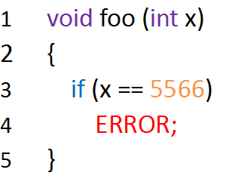
Random testing example
Random value for x
Probability of reaching ERROR = 1/2³²
Hard to rech the ERROR statement

Slide 10
Introduction
Determine what Inputs execute a designated part of a program
Assume “Inputs” are unknown beforehand
Assume inputs are λ, unknown “Symbolic” value
Expressions are expressed in terms of these Symbolic values
Conditional branch are expressed in terms of Constraints of the Symbolic values
Collect symbolic path constraints
Path Constraints: Constitute of Many Branch Conditions
Each branch condition may limit the branch destination

Slide 11
Introduction
Determine what Inputs execute a designated part of a program
Assume “Inputs” are unknown beforehand
Assume inputs are λ, unknown “Symbolic” value
y = read(); ⇒ assign λ to y
z = y * 3; ⇒ assign λ * 3 to z
Expressions are expressed in terms of these Symbolic values
Conditional branch are expressed in terms of Constraints of the Symbolic values
if (z == 21) ⇒ constraint (λ * 3 == 21) ⇒ resolve λ equal 7, and inputs need to be 7
else ⇒ constraint (λ * 3 != 21) ⇒ resolve λ to be 1,2,3,4,5,6,8,....
int f() { 2 ... 3 y = read(); 4 z = y * 3; 5 if (z == 21) { 6 fail(); 7 } else { 8 printf("OK"); 9 } 10 }

Slide 12
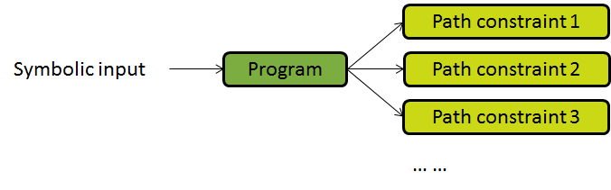
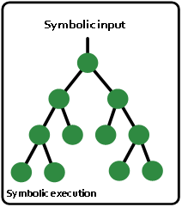
Symbolic Execution
Explore all feasible branches and record the information in path constraint

Slide 13
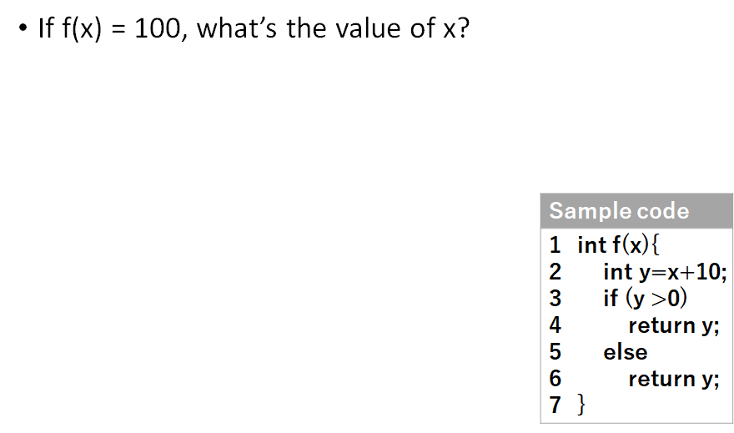
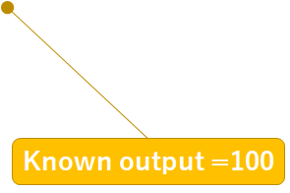
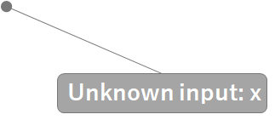
Constraint Solving

Slide 14
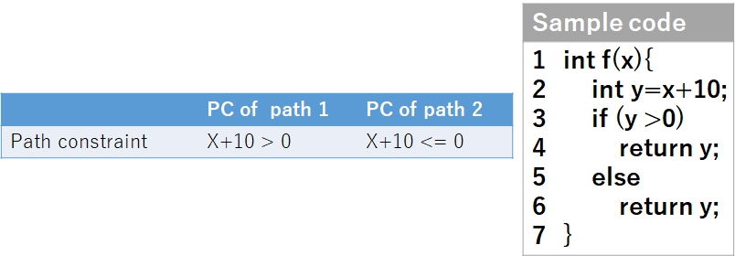
Constraint Solving
If f(x)= 100, what is the value of x ?
Use symbolic execution to get path constraint

Slide 15

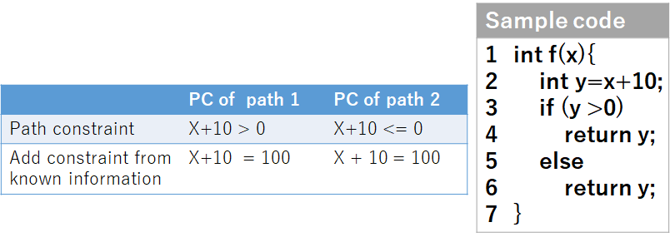
Constraint Solving
•If f(x) = 100, what’s the value of x?
•Use symbolic execution to get path constraint
•∵ f(x) = y = X+10 = 100
∴ Add path constraint X + 10 = 100

Slide 16
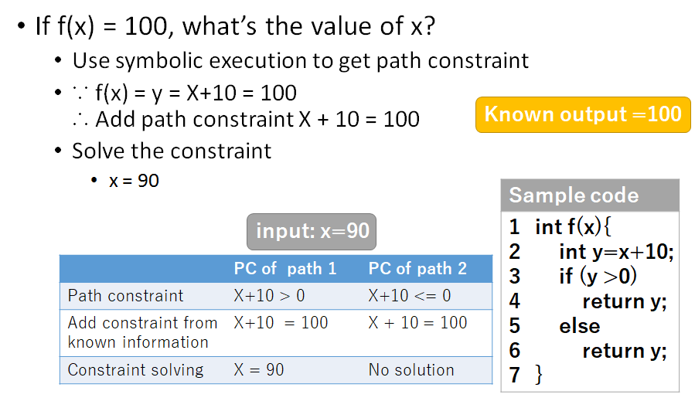
Constraint Solving

Slide 17
Issues and Limitation
Path Explosion
number of feasible patths grow exponentially in program size
may be infinite with unbounded loop
mitigation
heuristics for path-finding to increase code coverage
parallelizing independent paths
merging similar paths
reinforcement learning
Program-Dependent Efficient
Environment Interactions

Slide 18
Issues and Limitation
Path Explosion
number of feasible patths grow exponentially in program size
mitigations
Program-Dependent Efficient
reason the program path-by-path, instead of input-by-input
Environment Interactions

Slide 19
Issues and Limitation
Path Explosion
number of feasible patths grow exponentially in program size
mitigations
Program-Dependent Efficient
reason the program path-by-path, instead of input-by-input
Environment Interactions
interact with the environment: system calls, signals,

Slide 20
Issues and Limitation
int main() 2 { 3 FILE *fp = fopen("doc.txt"); 4 ... 5 if (condition) { 6 fputs("some data", fp); 7 } else { 8 fputs("some other data", fp); 9 } 10 ... 11 data = fgets(..., fp); 12 }
Path Explosion
number of feasible patths grow exponentially in program size
mitigations
Program-Dependent Efficient
reason the program path-by-path, instead of input-by-input
Environment Interactions
interact with the environment: system calls, signals,

Slide 21
Environment Interactions
Executing calls to th environment directly
Modeling the environment
instrument the system calls with a model simulating the effects in the state
must maintain the complex models of system calls
KLEE, Angr, Triton
Forking the entire systm state
Tools based on VM solve the problem by forking the entire VM state
in S2E, each state is an indepdendent VM snapshop
Higher memory usage overhead

Slide 22
Tools
Tool | Arch/Lang | url
KLEE | LLVM | http://klee.github.io/
FuzzBall | VineIL/Naive | http://bitblaze.cs.berkeley.edu/fuzzball.html
jCUTE | Java | https://github.com/osl/jcute
JPF | Java | http://babelfish.arc.nasa.gov/trac/jpf
S2E | x86,x86-64,ARM/User and kernel | http://s2e.epfl.ch
Mayhem | binary | http://forallsecure.com/mayhem.html
Triton | x86 and x86-64 | http://triton.quarkslab.com
Angr | libVEX based | http://angr.io/

Slide 23
Concolic testing
Treat program variables as symbolic variables, along a concrete execution path (based on testing on particular inputs)
combine concrete and symbolic execution
Concrete + Symbolic = Concolic
Tradtional symbolic execution
full-fledged symbolic interpreter for a programming language
Concolic testing
symbolic execution piggy-backed with normal execution of a program through instrumentation
Use concrete execution over a concrete input to guide symbolic execution

Slide 24
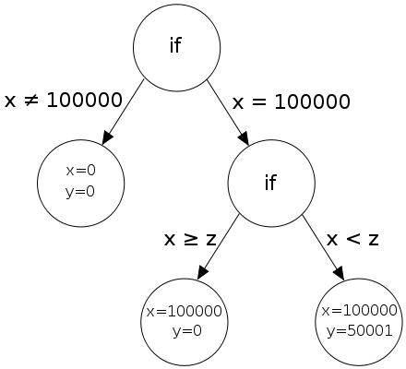
Example
random testing require impractically large number of tests to reproduce the failure
1 void f(int x, int y) { 2 int z = 2*y; 3 if (x == 100000) { 4 if (x < z) { 5 assert(0); /* error */ 6 } 7 } 8 }
concrete execution
symbolic execution
1: arbitray choice for x and y, x=y=0
2: z=0 and 0 ≠ 100000,
3: fail
1: x and y symbolic
2: z set to 2y
3: x ≠ 100000
1: x=100000 and y=0
2: z=0
3: x == 100000 pass
4: 1000000 < 0 fail
pc: x=100000 and x ≥ z
3: negate x ≠ 100000
obtain x=100000 and y=0
4: negate x ≥ z x=100000, z=2y
obtain x=100000 and y=50001

Slide 25
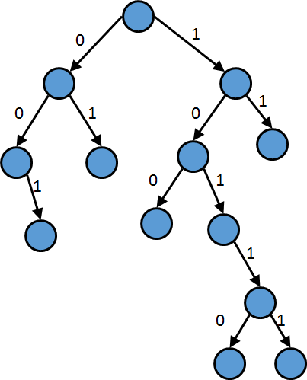
Concolic execution example

Slide 26
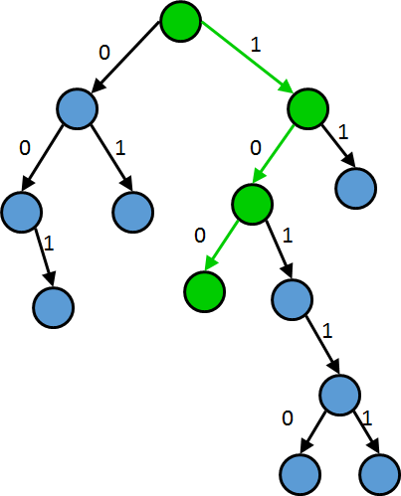

Slide 27
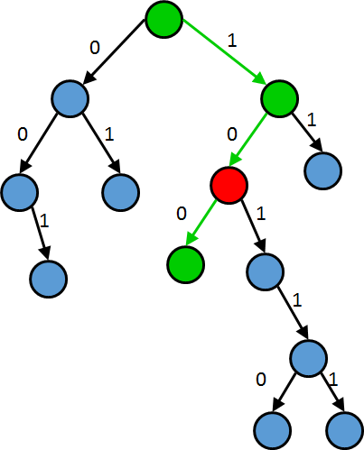

Slide 28
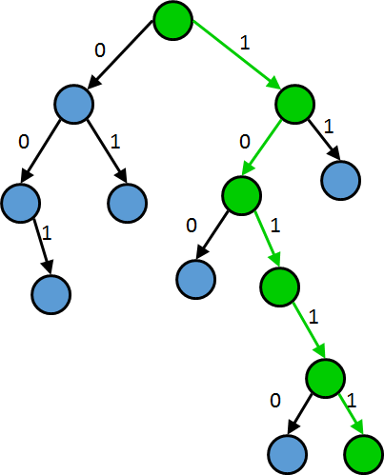

Slide 29
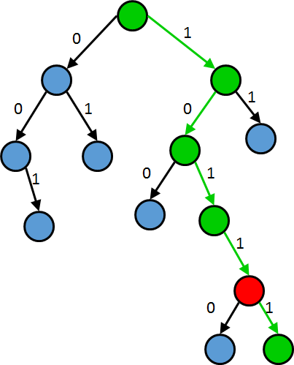

Slide 30
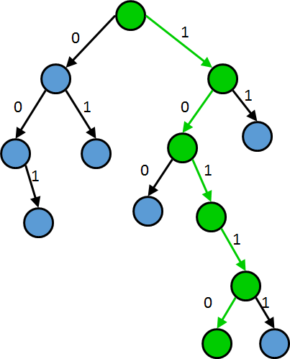

Slide 31
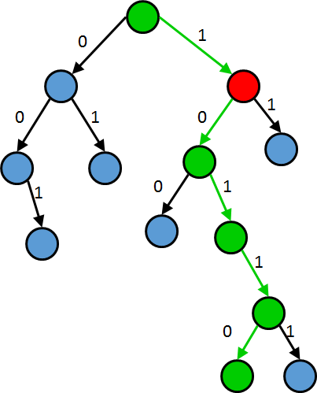

Slide 32
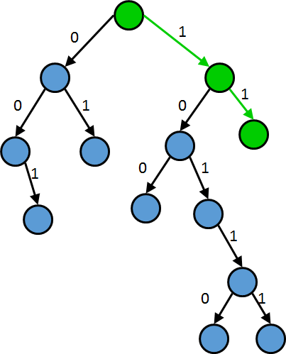

Slide 33
Development of SMT Solvers
Since 2005, dramatic improvement of efficiency and expressive power of SMT Solvers
theories, lazy solving, and improvements in the speed of SAT solvers
Z3, STP, Z3str2, Boolector

Slide 34
Pioneer Papers
Robert S. Boyer and Bernard Elspas and Karl N. Levitt SELECT--a formal system for testing and debugging programs by symbolic execution, Proceedings of the International Conference on Reliable Software, 1975,page 234--245, Los Angeles, California
James C. King,Symbolic execution and program testing, Communications of the ACM, volume 19, number 7, 1976, 385--394
William E. Howden, Experiments with a symbolic evaluation system, Proceedings, National Computer Conference, 1976.

Slide 35
History
1970s three papers
DART 2005
SAGE 2007
CUTE =>first coined the term concolic (2005)
EGT => EXE => KLEE (2005-2006)

